Slide 1
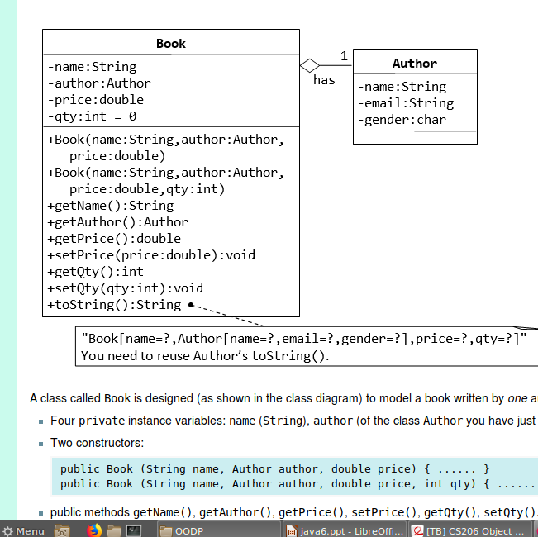
Write a program to implement the following class diagram

Slide 2
Inheritance
Inheritance allows the creation of hierarchical classifications
Using inheritance, you can create a general class
that defines traits common to a set of related items
In the terminology of Java, a class that is inherited is called a superclass. The class that does the inheriting is called a subclass.
Therefore, a subclass is a specialized version of a superclass. It inherits all of the members defined by the superclass and adds its own, unique elements.

Slide 3
Inheritance Basics
To inherit a class, you simply incorporate the definition of one class into another by using the extends keyword.
// Create a superclass.
class A {
int i, j;
void showij() {
System.out.println("i and j: " + i + " " + j);
}
}

Slide 4
// Create a subclass by extending class A.
class B extends A {
int k;
void showk() {
System.out.println("k: " + k);
}
void sum() {
System.out.println("i+j+k: " + (i+j+k));
}
}

Slide 5
class SimpleInheritance {
public static void main(String args []) {
A superOb = new A();
B subOb = new B();
// The superclass may be used by itself.
superOb.i = 10;
superOb.j = 20;
System.out.println("Contents of superOb: ");
superOb.showij();
System.out.println();

Slide 6
/* The subclass has access to all public members of its superclass. */
subOb.i = 7;
subOb.j = 8;
subOb.k = 9;
System.out.println("Contents of subOb: ");
subOb.showij();
subOb.showk();
System.out.println();
System.out.println("Sum of i, j and k in subOb:");
subOb.sum();
}
}

Slide 7
The output from this program is
Contents of superOb:
i and j: 10 20
Contents of subOb:
i and j: 7 8
k: 9
Sum of i, j and k in subOb:
i+j+k: 24

Slide 8
The general form of a class declaration that inherits a superclass is
class subclass-name extends superclass-name {
// body of class
}
Java does not support the inheritance of multiple superclasses into a single subclass.
You can, create a hierarchy of inheritance in which a subclass becomes a superclass of another subclass.
However, no class can be a superclass of itself.

Slide 9
Member Access and Inheritance
Although a subclass includes all of the members of its superclass, it cannot access those members of the superclass that have been declared as private
class A {
int i; // public by default
private int j; // private to A
void setij(int x, int y) {
i = x;
j = y;
}
}

Slide 10
Member access and inheritance
class B extends A {
int total;
void sum() {
total = i + j; // ERROR, j is not accessible here
}}
class Access {
public static void main(String args[]) {
B subOb = new B();
subOb.setij(10, 12);
subOb.sum();
System.out.println("Total is " + subOb.total);
}}

Slide 11
A class member that has been declared as private will remain private to its class. It is not accessible by any code outside its class, including subclasses.

Slide 12
class Box {
double width;
double height;
double depth;
// construct clone of an object
Box(Box ob) { // pass object to constructor
width = ob.width;
height = ob.height;
depth = ob.depth;
}

Slide 13
// constructor used when all dimensions specified
Box(double w, double h, double d) {
width = w;
height = h;
depth = d;
}
// constructor used when all dimensions specified
Box(double w, double h, double d) {
width = w;
height = h;
depth = d;
}

Slide 14
// constructor
Box() {
width = -1;
height = -1;
depth = -1;
}
// constructor used when cube is created
Box(double len) {
width = height = depth = len;
}
// compute and return volume
double volume() {
return width * height * depth;
}
}

Slide 15
// Here, Box is extended to include weight.
class BoxWeight extends Box {
double weight; // weight of box
// constructor for BoxWeight
BoxWeight(double w, double h, double d, double m) {
width = w;
height = h;
depth = d;
weight = m;
}
}

Slide 16
class DemoBoxWeight {
public static void main(String args[]) {
BoxWeight mybox1 = new BoxWeight(10, 20, 15, 34.3);
BoxWeight mybox2 = new BoxWeight(2, 3, 4, 0.076);
double vol;
vol = mybox1.volume();
System.out.println("Volume of mybox1 is " + vol);
System.out.println("Weight of mybox1 is " + mybox1.weight);
System.out.println();
vol = mybox2.volume();
System.out.println("Volume of mybox2 is " + vol);
System.out.println("Weight of mybox2 is " + mybox2.weight);
}
}

Slide 17
The output from this program is :
Volume of mybox1 is 3000.0
Weight of mybox1 is 34.3
Volume of mybox2 is 24.0
Weight of mybox2 is 0.076

Slide 18
A Superclass Variable Can Reference a Subclass Object
class RefDemo {
public static void main(String args[]) {
BoxWeight weightbox = new BoxWeight(3, 5, 7, 8.37);
Box plainbox = new Box();
double vol;
vol = weightbox.volume();
System.out.println("Volume of weightbox is " + vol);
System.out.println("Weight of weightbox is " + weightbox.weight);
System.out.println();

Slide 19
// assign BoxWeight reference to Box reference
plainbox = weightbox;
vol = plainbox.volume(); // OK, volume() defined in Box
System.out.println("Volume of plainbox is " + vol);
/* The following statement is invalid because plainbox
does not define a weight member. */
System.out.println("Weight of plainbox is " + plainbox.weight);
//
}
}

Slide 20
it is the type of the reference variable—not the type of the object that it refers to—that determines what members can be accessed.
That is, when a reference to a subclass object is assigned to a superclass reference variable, you will have access only to those parts of the object defined by the superclass.

Slide 21
Using super
Whenever a subclass needs to refer to its immediate superclass, it can do so by use of the keyword super.
super has two general forms.
  The first calls the superclass’ constructor.
  The second is used to access a member of the superclass that has been hidden by a member of a subclass.

Slide 22
Using super to Call Superclass Constructors
super(arg-list);
class BoxWeight extends Box {
double weight; // weight of box
// initialize width, height, and depth using super()
BoxWeight(double w, double h, double d, double m) {
super(w, h, d); // call superclass constructor
weight = m;
}}

Slide 23
super()
In the preceding example, super( ) was called with three arguments.
Since constructors can be overloaded, super( ) can be called using any form defined by the superclass.
The constructor executed will be the one that matches the arguments.

Slide 24
// BoxWeight now fully implements all constructors.
class BoxWeight extends Box {
double weight; // weight of box
// construct clone of an object
BoxWeight(BoxWeight ob) { // pass object to constructor
super(ob);
weight = ob.weight;
}

Slide 25
// constructor when all parameters are specified
BoxWeight(double w, double h, double d, double m) {
super(w, h, d); // call superclass constructor
weight = m;
}
// default constructor
BoxWeight() {
super();
weight = -1;
}
// constructor used when cube is created
BoxWeight(double len, double m) {
super(len);
weight = m;
}
}

Slide 26
class DemoSuper {
public static void main(String args[]) {
BoxWeight mybox1 = new BoxWeight(10, 20, 15, 34.3);
BoxWeight mybox2 = new BoxWeight(2, 3, 4, 0.076);
BoxWeight mybox3 = new BoxWeight(); // default
BoxWeight mycube = new BoxWeight(3, 2);
BoxWeight myclone = new BoxWeight(mybox1);
double vol;
vol = mybox1.volume();
System.out.println("Volume of mybox1 is " + vol);
System.out.println("Weight of mybox1 is " + mybox1.weight);
System.out.println();
}
}

Slide 27
public class Test {
public static void main(String[] args)
{
String s1 = new String("HELLO");
String s2 = new String("HELLO");
System.out.println(s1 == s2);
System.out.println(s1.equals(s2));
}
}
Output:
false
true

Slide 28
super()
// construct clone of an object
BoxWeight(BoxWeight ob) { // pass object to constructor
super(ob);
weight = ob.weight;
}
Notice that super( ) is passed an object of type BoxWeight—not of type Box. This still invokes the constructor Box(Box ob).
A superclass variable can be used to reference any object derived from that class. Thus, we are able to pass a BoxWeight object to the Box constructor.

Slide 29
super()
super( ) always refers to the superclass immediately above the calling class. This is true even in a multileveled hierarchy.
Also, super( ) must always be the first statement executed inside a subclass constructor.

Slide 30
A Second Use for super
The second form of super acts somewhat like this, except that it always refers to the superclass of the subclass in which it is used.
This usage has the following general form:
super.member
Here, member can be either a method or an instance variable.
This second form of super is most applicable to situations in which member names of a subclass hide members by the same name in the superclass.

Slide 31
super
// Using super to overcome name hiding.
class A {
int i;
}
// Create a subclass by extending class A.
class B extends A {
int i; // this i hides the i in A
B(int a, int b) {
super.i = a; // i in A
i = b; // i in B
}

Slide 32
super
void show() {
System.out.println("i in superclass: " + super.i);
System.out.println("i in subclass: " + i);
}
}
class UseSuper {
public static void main(String args[]) {
B subOb = new B(1, 2);
subOb.show();
}}
OUTPUT:i in superclass: 1
i in subclass: 2

Slide 33
Creating a Multilevel Hierarchy
// Extend BoxWeight to include shipping costs.
// Start with Box.
class Box {
private double width;
private double height;
private double depth;
.
.
,
}

Slide 34
class BoxWeight extends Box {
double weight; // weight of box
// construct clone of an object
BoxWeight(BoxWeight ob) { // pass object to constructor
super(ob);
weight = ob.weight;
}
// constructor when all parameters are specified
BoxWeight(double w, double h, double d, double m) {
super(w, h, d); // call superclass constructor
weight = m;
}
...
.
}

Slide 35
class Shipment extends BoxWeight {
double cost;
// construct clone of an object
Shipment(Shipment ob) { // pass object to constructor
super(ob);
cost = ob.cost;
}
// constructor when all parameters are specified
Shipment(double w, double h, double d,
double m, double c) {
super(w, h, d, m); // call superclass constructor
cost = c;
}
.
.
.}

Slide 36
class DemoShipment {
public static void main(String args[]) {
Shipment shipment1 =
new Shipment(10, 20, 15, 10, 3.41);
Shipment shipment2 =
new Shipment(2, 3, 4, 0.76, 1.28);
double vol;
vol = shipment1.volume();
System.out.println("Volume of shipment1 is " + vol);
System.out.println("Weight of shipment1 is "
+ shipment1.weight);
System.out.println("Shipping cost: $" + shipment1.cost);
System.out.println();
}
}

Slide 37
In the preceding program, the entire class hierarchy, including Box, BoxWeight, and Shipment, is shown all in one file. This is for your convenience only.
In Java, all three classes could have been placed into their own files and compiled separately.

Slide 38
class A {
A() {
System.out.println("Inside A's constructor.");
}}
class B extends A {
B() {
System.out.println("Inside B's constructor.");
}}
class C extends B {
C() {
System.out.println("Inside C's constructor.");
}}
class CallingCons {
public static void main(String args[]) {
C c = new C();
}}

Slide 39
Method Overriding
In a class hierarchy, when a method in a subclass has the same name and type signature as a method in its superclass, then the method in the subclass is said to override the method in the superclass.
When an overridden method is called from within its subclass, it will always refer to the version of that method defined by the subclass. The version of the method defined by the superclass will be hidden.

Slide 40
Method overriding
// Method overriding.
class A {
int i, j;
A(int a, int b) {
i = a;
j = b;
}
// display i and j
void show() {
System.out.println("i and j: " + i + " " + j);
}
}

Slide 41
Method overriding
class B extends A {
int k;
B(int a, int b, int c) {
super(a, b);
k = c;
}
// display k – this overrides show() in A
void show() {
System.out.println("k: " + k);
}
}

Slide 42
Method overriding
class Override {
public static void main(String args[]) {
B subOb = new B(1, 2, 3);
subOb.show(); // this calls show() in B
}
}
The output produced by this program is :
k: 3

Slide 43
Method overriding
If you wish to access the superclass version of an overridden method, you can do so by using super.
class B extends A {
int k;
B(int a, int b, int c) {
super(a, b);
k = c;
}

Slide 44
Method overriding
void show() {
super.show(); // this calls A's show()
System.out.println("k: " + k);
}
}
output:
i and j: 1 2
k: 3

Slide 45
Method overriding occurs only when the names and the type signatures of the two methods are identical. If they are not, then the two methods are simply overloaded.
class A {
int i, j;
A(int a, int b) {
i = a;
j = b;
}
// display i and j
void show() {
System.out.println("i and j: " + i + " " + j);
}
}

Slide 46
// Create a subclass by extending class A.
class B extends A {
int k;
B(int a, int b, int c) {
super(a, b);
k = c;
}
// overload show()
void show(String msg) {
System.out.println(msg + k);
}
}

Slide 47
class Override {
public static void main(String args[]) {
B subOb = new B(1, 2, 3);
subOb.show("This is k: "); // this calls show() in B
subOb.show(); // this calls show() in A
}
}
The output produced by this program is shown here:
This is k: 3
i and j: 1 2

Slide 48
Dynamic Method Dispatch
Dynamic method dispatch is the mechanism by which a call to an overridden method is resolved at run time, rather than compile time.
Dynamic method dispatch is important because this is how Java implements run-time polymorphism.
When an overridden method is called through a superclass reference, Java determines which version of that method to execute based upon the type of the object being referred to at the time the call occurs. Thus, this determination is made at run time.

Slide 49
Dynamic method dispatch
class A {
void callme() {
System.out.println("Inside A's callme method");
}
}
class B extends A {
// override callme()
void callme() {
System.out.println("Inside B's callme method");
}
}

Slide 50
class C extends A {
// override callme()
void callme() {
System.out.println("Inside C's callme method");
}
}
class Dispatch {
public static void main(String args[]) {
A a = new A(); // object of type A
B b = new B(); // object of type B
C c = new C(); // object of type C
A r; // obtain a reference of type A
r = a; // r refers to an A object
r.callme(); // calls A's version of callme

Slide 51
r = b; // r refers to a B object
r.callme(); // calls B's version of callme
r = c; // r refers to a C object
r.callme(); // calls C's version of callme
}
}
OUTPUT:
Inside A's callme method
Inside B's callme method
Inside C's callme method

Slide 52
Why Overridden Methods?
Overridden methods allow Java to support run-time polymorphism.
it allows a general class to specify methods that will be common to all of its derivatives, while allowing subclasses to define the specific implementation of some or all of those methods.
By combining inheritance with overridden methods, a superclass can define the general form of the methods that will be used by all of its subclasses.

Slide 53
Why overriden methods?
Dynamic, run-time polymorphism is one of the most powerful mechanisms that object-oriented design brings to bear on code reuse and robustness.
The ability of existing code libraries to call methods on instances of new classes without recompiling while maintaining a clean abstract interface is a profoundly powerful tool.

Slide 54
Question
Write a program which creates a superclass called Figure and 2 subclassess Rectangle and Triangle.Find the area of object using method overriding.

Slide 55
Using Abstract Classes
Define a superclass that declares the structure of a given abstraction without providing a complete implementation of every method.
That is, sometimes you will want to create a superclass that only defines a generalized form that will be shared by all of its subclasses, leaving it to each subclass to fill in the details.
Such a class determines the nature of the methods that the subclasses must implement.

Slide 56
Abstract classes
You may have methods that must be overridden by the subclass in order for the subclass to have any meaning.
To ensure that a subclass override all necessary methods, Java’s solution is the abstract method.

Slide 57
Abstract classes
You can require that certain methods be overridden by subclasses by specifying the abstract type modifier.
These methods are sometimes referred to as subclasser responsibility because they have no implementation specified in the superclass.
Thus, a subclass must override them—it cannot simply use the version defined in the superclass.

Slide 58
Abstract classes
abstract type name(parameter-list); //No method body is present.
Any class that contains one or more abstract methods must also be declared abstract.
To declare a class abstract, you simply use the abstract keyword in front of the class keyword at the beginning of the class declaration.
There can be no objects of an abstract class. That is, an abstract class cannot be directly instantiated with the new operator.
You cannot declare abstract constructors, or abstract static methods.
Any subclass of an abstract class must either implement all of the abstract methods in the superclass, or be declared abstract itself.

Slide 59
// A Simple demonstration of abstract.
abstract class A {
abstract void callme();
// concrete methods are still allowed in abstract classes
void callmetoo() {
System.out.println("This is a concrete method.");
}
}
class B extends A {
void callme() {
System.out.println("B's implementation of callme.");
}
}

Slide 60
class AbstractDemo {
public static void main(String args[]) {
B b = new B();
b.callme();
b.callmetoo();
}
}
Although abstract classes cannot be used to instantiate objects, they can be used to create object references, because Java’s approach to run-time polymorphism is implemented through the use of superclass references.

Slide 61
Using final with Inheritance
Using final to Prevent Overriding
Final cannot be overriden.
class A {
final void meth() {
System.out.println("This is a final method.");
}
}
class B extends A {
void meth() { // ERROR! Can't override.
System.out.println("Illegal!");
}
}

Slide 62
Using final to Prevent Inheritance
precede the class declaration with final. Declaring a class as final implicitly declares all of its methods as final, too.
final class A {
//...
}
// The following class is illegal.
class B extends A { // ERROR! Can't subclass A
//...
}

Slide 63
it is illegal to declare a class as both abstract and final since an abstract class is incomplete by itself and relies upon its subclasses to provide complete implementations

Slide 64
The Object Class
Object is a superclass of all other classes.
This means that a reference variable of type Object can refer to an object of any other class.
Also, since arrays are implemented as classes, a variable of type Object can also refer to any array.

Slide 65
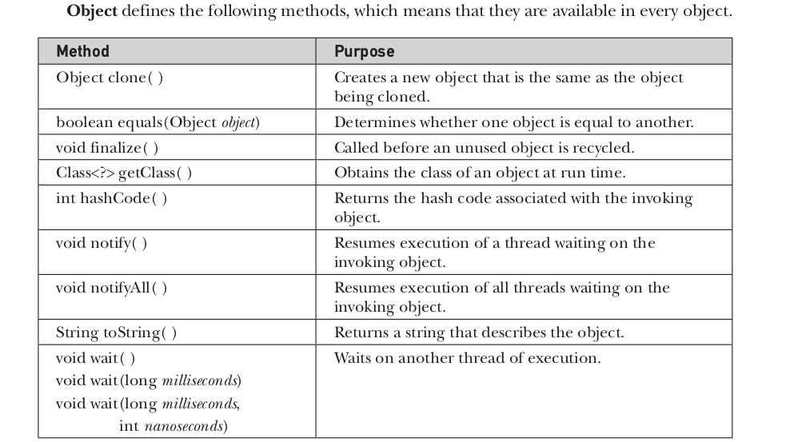
The Object class

Slide 66
The Object class
The methods getClass( ), notify( ), notifyAll( ), and wait( ) are declared as final. You may override the others.
The equals( ) method compares two objects. It returns true if the objects are equal, and false otherwise. The precise definition of equality can vary, depending on the type of objects being compared.
The toString( ) method returns a string that contains a description of the object on which it is called. Also, this method is automatically called when an object is output using println( ).

